Slide 1
Information Search
Ying shen
Sse, tongji university
Jan. 2018

Slide 2
Outline
Introduction
Five-stage search framework
Dynamic queries and faceted search
Command languages and “natural” language queries
Multimedia Document Search & specialized search
The Social aspects of search

Slide 3
Outline
Introduction
Five-stage search framework
Dynamic queries and faceted search
Command languages and “natural” language queries
Multimedia Document Search & specialized search
The Social aspects of search

Slide 4
Introduction
The indexing and retrieval of textual documents.
Searching for pages on the World Wide Web is the “killer app.”
Concerned firstly with retrieving relevant documents to a query.
Concerned secondly with retrieving from large sets of documents efficiently.
Notes:
In marketing terminology, a killer application (commonly shortened to killer app) is any computer program that is so necessary or desirable that it proves the core value of some larger technology, such as computer hardware, a gaming console, software, a programming language, a software platform, or an operating system.^{[1]} In other words, consumers would buy the (usually expensive) hardware just to run that application. A killer app can substantially increase sales of the platform on which it runs.

Slide 5
Typical IR tasks
Given:
A corpus of textual natural-language documents.
A user query in the form of a textual string.
Find:
A ranked set of documents that are relevant to the query.
Some examples of tasks
Specific fact finding (known-item search)
What are the hotels near Tongji University?
Extended fact finding
What are differences between the butterfly and the moth?
Exploration of availability
Are there new restaurants open near Tongji University this month?
Open-ended browsing and problem analysis
Are there promising new treatments for Parkinson disease?

Slide 6
IR system
Document
corpus
IR
System
Query String
1. Doc1
2. Doc2
3. Doc3
.
.
Ranked
Documents

Slide 7
Relevance
Relevance is a subjective judgment and may include:
Being on the proper subject.
Being timely (recent information).
Being authoritative (from a trusted source).
Satisfying the goals of the user and his/her intended use of the information (information need).

Slide 8
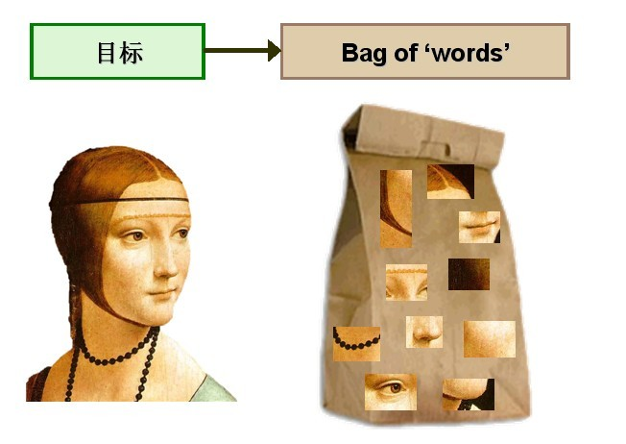
Keyword search
Simplest notion of relevance is that the query string appears verbatim in the document.
Slightly less strict notion is that the words in the query appear frequently in the document, in any order (bag of words).
Notes:
BoW模型最初应用于文本处理领域，用来对文档进行分类和识别。BoW 模型因为其简单有效的优点而得到了广泛的应用。其基本原理可以用以下例子来给予描述。给定两句简单的文档：
文档 1：“我喜欢跳舞，小明也喜欢。”
文档 2：“我也喜欢唱歌。”
基于以上这两个文档，便可以构造一个由文档中的关键词组成的词典：
词典={1:“我”，2:“喜欢”，3:“跳舞”，4:“小明”，5:“也”，6:“唱歌”}
这个词典一共包含6个不同的词语，利用词典的索引号，上面两个文档每一个都可以用一个6维向量表示（用整数数字0~n（n为正整数）表示某个单词在文档中出现的次数。这样，根据各个文档中关键词出现的次数，便可以将上述两个文档分别表示成向量的形式：
文档 1：[1, 2, 1, 1, 1, 0]
文档 2：[1, 1, 0, 0, 1, 1]

Slide 9
Problems with keywords
May not retrieve relevant documents that include synonymous terms.
“restaurant” vs. “café”
“PRC” vs. “China”
May retrieve irrelevant documents that include ambiguous terms.
“bat” (baseball vs. mammal)
“Apple” (company vs. fruit)
“bit” (unit of data vs. act of eating)

Slide 10
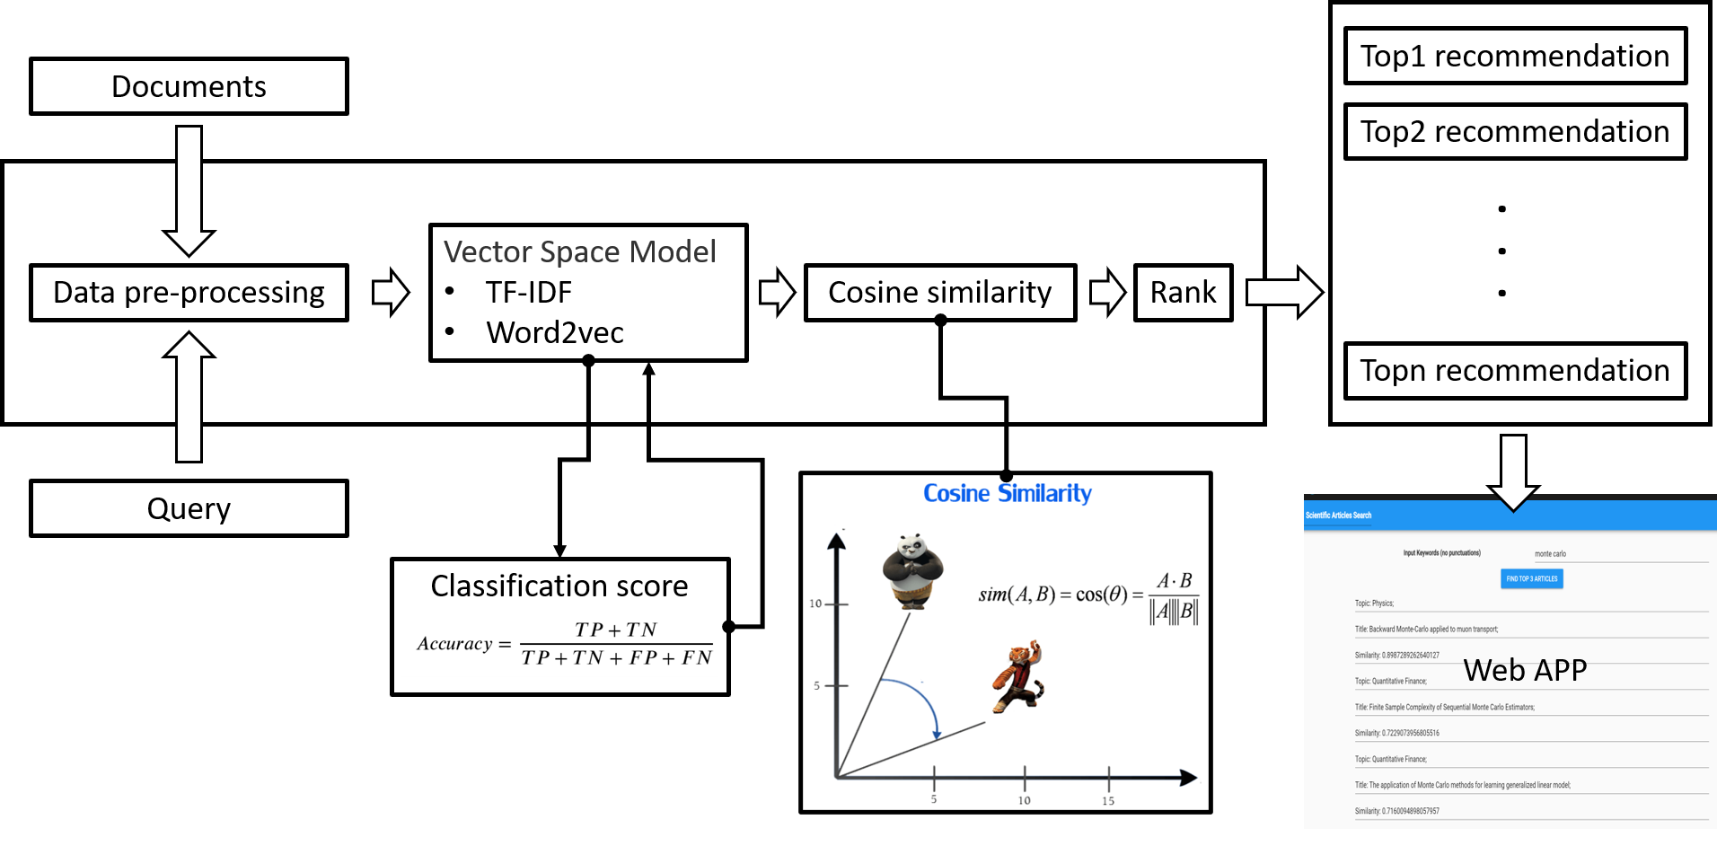
Information retrieval and word embedding

Slide 11
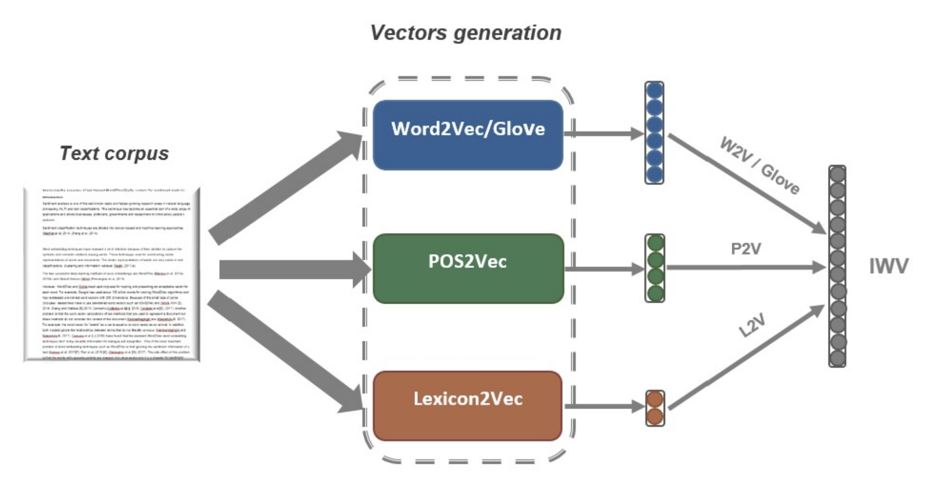

Slide 12
Intelligent IR
Taking into account the meaning of the words used.
Taking into account the order of words in the query.
Adapting to the user based on direct or indirect feedback.
Taking into account the authority of the source.

Slide 13
Web search
Application of IR to HTML documents on the World Wide Web.
Differences:
Must assemble document corpus by spidering the web.
Can exploit the structural layout information in HTML (XML).
Documents change uncontrollably.
Can exploit the link structure of the web.

Slide 14
Web search system
Web
Spider
Document
corpus
IR
System
Query String
1. Page1
2. Page2
3. Page3
.
.
Ranked
Documents

Slide 15
Other IR-related tasks
Automated document categorization
Information filtering (spam filtering)
Information routing
Automated document clustering
Recommending information or products
Information extraction
Information integration
Question answering
Notes:
IE的目标是从文档中获取相关的信息。20世纪90年代初，人们开始关注信息提取(information extration)相关研究。之后信息提取算法方面取得很大进展，自动识别命名实体(人名、组织名等)方面取得巨大进步。随着Web的出现和繁荣，IE研究人员逐渐将兴趣转移到Web网页信息提取的研究上。其中比较知名的项目是卡耐基梅隆大学自动学习和发现中心的Web挖掘项目，他们采用机器学习算法，目标是通过训练自动地从Web中提取信息。
信息抽取主要包括三个子任务：
实体抽取与链指：也就是命名实体识别
关系抽取：通常我们说的三元组(triple)抽取，主要用于抽取实体间的关系
事件抽取：相当于一种多元关系的抽取

Slide 16
History of IR
1960-70’s:
Initial exploration of text retrieval systems for “small” corpora of scientific abstracts, and law and business documents.
Development of the basic Boolean and vector-space models of retrieval.
Prof. Salton and his students at Cornell University are the leading researchers in the area.

Slide 17
History of IR
1980’s:
Large document database systems, many run by companies:
Lexis-Nexis
Dialog
MEDLINE
1990’s:
Searching FTPable documents on the Internet
Archie
WAIS
Searching the World Wide Web
Lycos
Yahoo
Altavista
Notes:
Lexis-Nexis：https://www.lexisnexis.com/en-us/home.page
MEDLINE：http://apps.webofknowledge.com/MEDLINE_GeneralSearch_input.do?product=MEDLINE&SID=6A6XNJoyDgTMuZMufuU&search_mode=GeneralSearch
1990年，由于当时并没有出现www（万维网），所以ftp（文件传输协议）软件成为了共享文件的主要工具。但是要共享文件，必须要一个ftp服务器。当时检索ftp数据也要必须使用ftp客户端，然而很多数据都是零散分布在各个不同的地方的。然而就催生了搜索引擎的祖先—Archie。
1990年，加拿大蒙特利尔的麦吉尔大学（McGill University）的三位学生Alan Emtage、Peter Deutsch、Bill Wheelan发明了Archie。
当时的Internet可以提供诸如FTP等文件信息服务，然而用户却缺乏一种直接查询FTP文件所在地址的工具。而Archie恰恰可以自动索引Internet上匿名的免费FTP文件信息，并提供一种根据文件名称查询文件所在FTP地址的方法。因此，Archie被称为现代搜索引擎的祖先。
Lycos是搜索引擎中的元老，是最早提供信息搜索服务的网站之一，2000年被西班牙网络集团Terra Lycos Network以125亿美元收归旗下。
Altavista是全球最知名的搜索引擎公司之一，同时提供搜索引擎后台技术支持等相关产品。AltaVista是一个以网页全文检索为主、同时提供分类目录的搜索引擎。内容极其丰富，真正可以称海量信息检索。AltaVista于1995年由迪吉多公司(Digital Equipment Corporation)创立。2003年被 Overture 以1.4亿美元现金加股票的形式购得，同年转手给雅虎 ^{[1]} 。北京时间2013年6月29日，雅虎宣布将于2013年7月8日关闭搜索引擎AltaVista服务。

Slide 18
History of IR
1990’s continued:
Organized Competitions
NIST TREC
Recommender Systems
Ringo
Amazon
NetPerceptions
Automated Text Categorization & Clustering
Notes:
https://trec.nist.gov/该会议细分为几大主要方向：问题回答（QA）、特定领域检索（Legal、Genomics、Enterprise、Blog）、传统Web检索等。
自动文本分类（automatic text categorization）算法大致可以分为两类：知识工程（knowledge engineering）方法和机器学习（machine learning）方法。
文本聚类有很多应用，比如提高IR系统的查全率，导航/组织电子资源，等等。www.vivisimo.com是一个成熟的文本聚类系统。

Slide 19
History of IR
2000’s
Link analysis for Web Search
Google
Automated Information Extraction
Parallel Processing
Map/Reduce
Question Answering
TREC Q/A track
Multimedia IR
Image
Video
Audio and music
Cross-Language IR
DARPA Tides
Document Summarization
Learning to Rank
Notes:
语言信息的检索（包括检测、抽取和摘要等）历来受到 ＤＡＲＰＡ的重视。早在 １９９１年，ＤＡＲＰＡ就发起了旨在促进信息检索、信息抽取以及自动文摘等领域研究的ＴＩＰＳＴＥＲ项目［５］。１９９６年，ＤＡＲＰＡ启动了话题检测和跟踪（ｔｏｐｉｃｄｅｔｅｃｔｉｏｎａｎｄｔｒａｃｋｉｎｇ，ＴＤＴ）项目，通过对新闻媒体信息进行新话题的自动识别和已知话题的持续跟踪帮助用户应对日益严重的网络信息过载问题。１９９８年，ＴＩＰＳＴＥＲ项目由于资金原因被迫中止。在此之后，ＤＡＲＰＡ于１９９９年启动了跨语言信息检测、抽取和摘要（ｔｒａｎｓ ｌｉｎｇｕａｌｉｎｆｏｒｍａｔｉｏｎ ｄｅｔｅｃｔｉｏｎ，ｅｘｔｒａｃｔｉｏｎ，ａｎｄ ｓｕｍｍａｒｉｚａｔｉｏｎ，ＴＩＤＥＳ）项目，旨在开发高级的语言处理技术以自动处理和理解多样化的人类语言数据，尤其是使英语使用者不受语种和媒介的限制快速获取和理解非英语信息中的关键内容，其中阿拉伯语和汉语是ＴＩＤＥＳ项目的重点语种。

Slide 20
Recent IR history
2010’s
Intelligent Personal Assistants
Siri
Cortana
Google Now
Alexa
Complex Question Answering
IBM Watson
Distributional Semantics
Deep Learning

Slide 21
Outline
Introduction
Five-stage search framework
Dynamic queries and faceted search
Command languages and “natural” language queries
Multimedia Document Search & specialized search
The Social aspects of search

Slide 22
Five-stage search framework
A five-stage search framework help to coordinate design practices and satisfy the needs of all users
Formulation
Initiation of action
Review of results
Refinement
Use
Five-stages can be repeated until users’ needs are met
If users’ are unsatisfied with the results, they should be able to have additional options and change their queries easily
Notes:
Formulation: Expressing the search
Initiation of action: Launching the search
Review of results: Reading messages and outcome
Refinement: Formulating the next step
Use: Compiling or disseminating insight

Slide 23
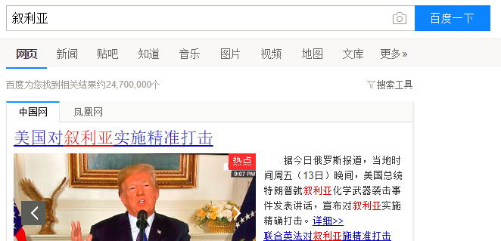
Formulation
This stage includes identifying the source of the information
The limitation of the source can lead to better results or failures
Users prefer to search a specific library
Using keywords, phrases and structured fields to limit the search scope
Text boxes, menus, and form fill-in
Users or service providers should have stop lists
Notes:
http://www.lib.tongji.edu.cn/site/tongji/cc7cff7c-bbf8-4f04-a006-281d35ebb076/index.html
http://apps.webofknowledge.com/UA_GeneralSearch_input.do?product=UA&search_mode=GeneralSearch&SID=6CBqnGjVb3edu7Dg81o&preferencesSaved=
Use simple and advance search
Limit the search using structured fields such as year, media, or location
Recognize phrases to allow entry of names, such as “George Washington”
Permit variants to allow relaxation of search constraints (e.g. phonetic variations)
Control the size of the initial result set
Use scoping of source carefully
Provide suggestions, hints, and common sources

Slide 24
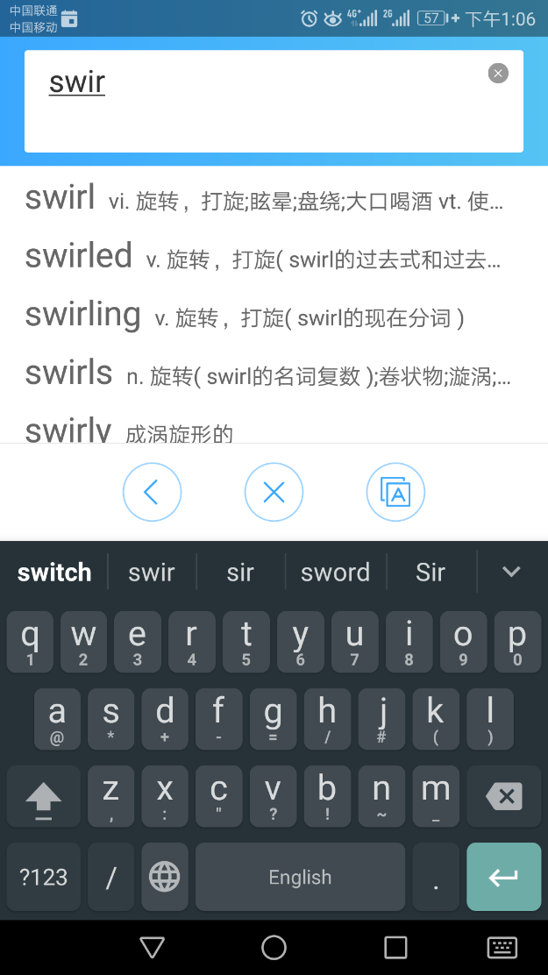
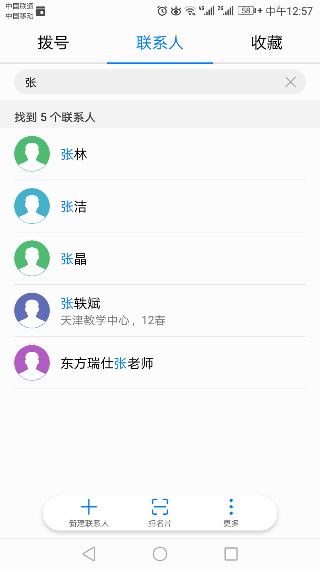
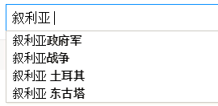
Formulation
When users are unsure of the exact value of the field, variants can be accepted
Case sensitivity, stemmed version, partial match, phonetic variant, synonym, abbreviation, ...
The result list can be displayed as users type.
Auto-completion can speed data entry, help users recall terms of interest, and limits misspelling

Slide 25
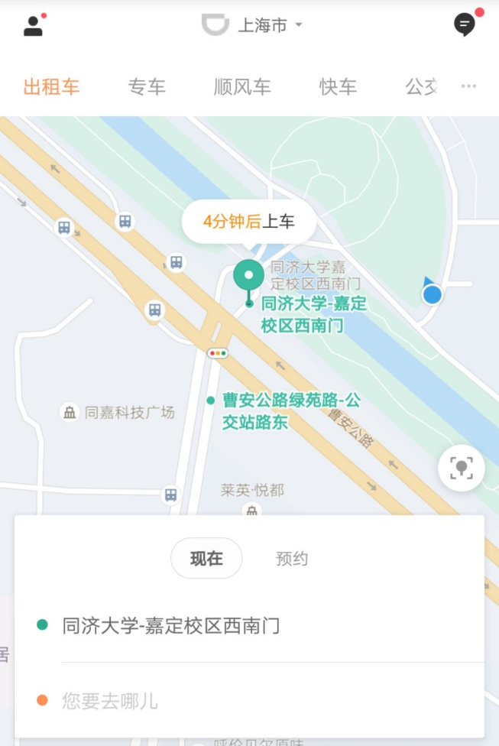
Formulation
Mobile applications may use context information such as location to narrow down the auto-completion

Slide 26

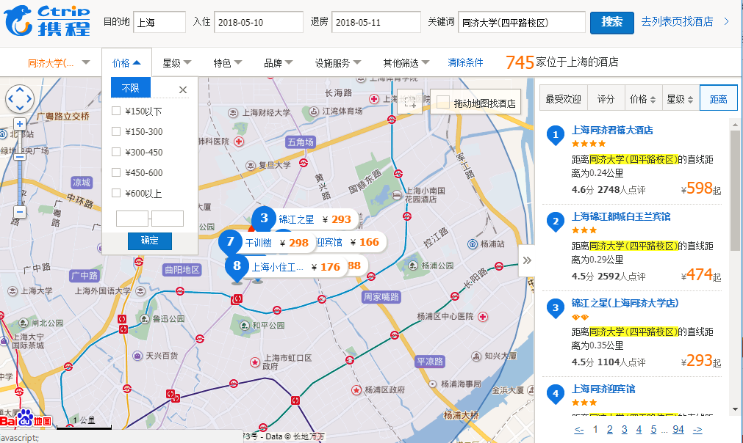
Initiation of action
Explicit search
A search button
A magnifier glass is the standard icon for search
Pressing the Enter key on a keyboard
Pausing during spoken interaction
Implicit search
Dynamic queries

Slide 27
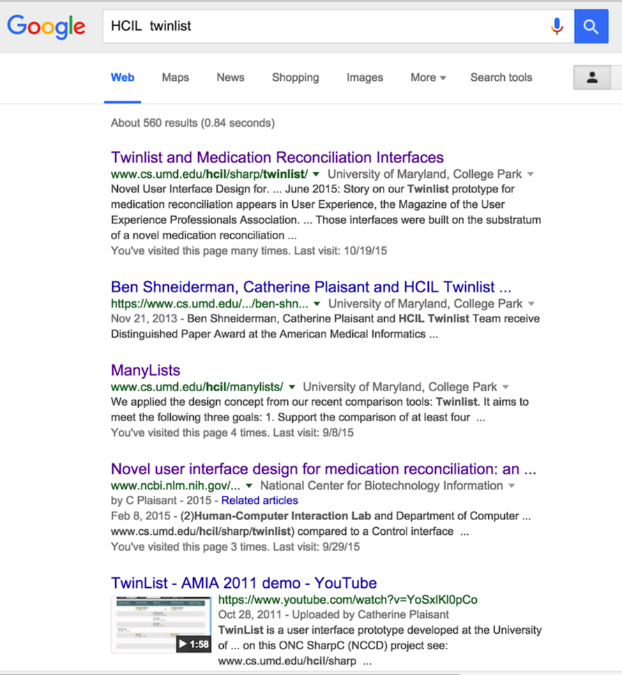
Review of results
Users review results in textual list, on geographical maps, timelines, or other specialized visual overviews of results
A Google Search result list
A summary is provided at the top (the total number of results)
Each result includes preview information (or snippet)
Search terms are highlighted, including “Human-Computer Interaction Lab” which is the expanded variant of the search term HCIL
The name of the top-level organization was added (here “National Center for Biotechnology Information”) to help users judge the trustiness of the information
Notes:
If no items are found, the failure should be indicated clearly
When results are presented in a list, it is common to return only about 20 results, but larger initial sets are preferable for those with high band-width and large displays.

Slide 28
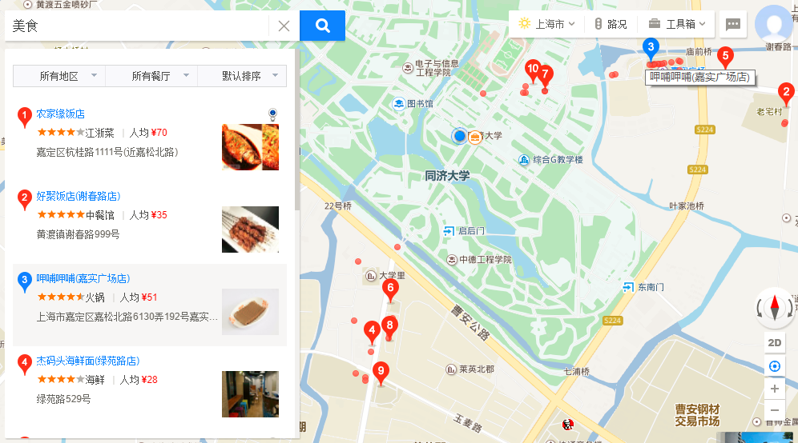
Review of results
Notes:
Searching for Annapolis on the real estate website Zillow returns a list of houses and dots displayed on a map.
The two windows are coordinated; when the cursor hovers over a house in the result list, the location of the house is indicated on the map.
A click on the house would bring all the details displayed in an overlapping window.

Slide 29
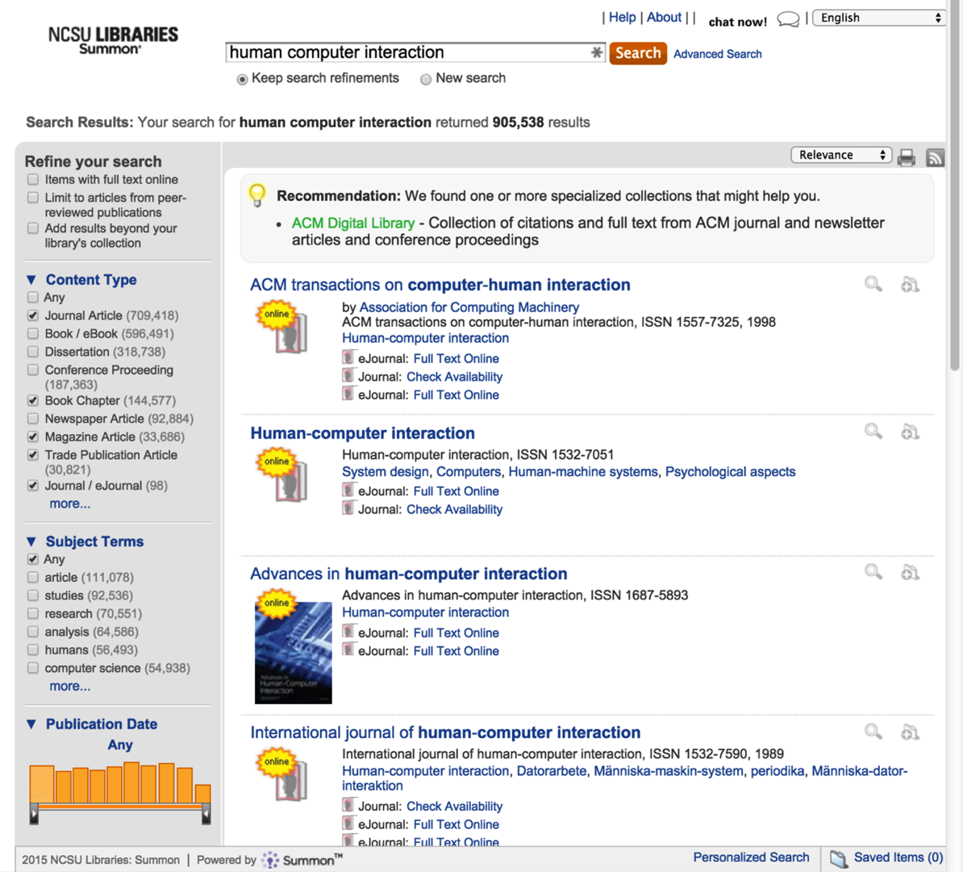
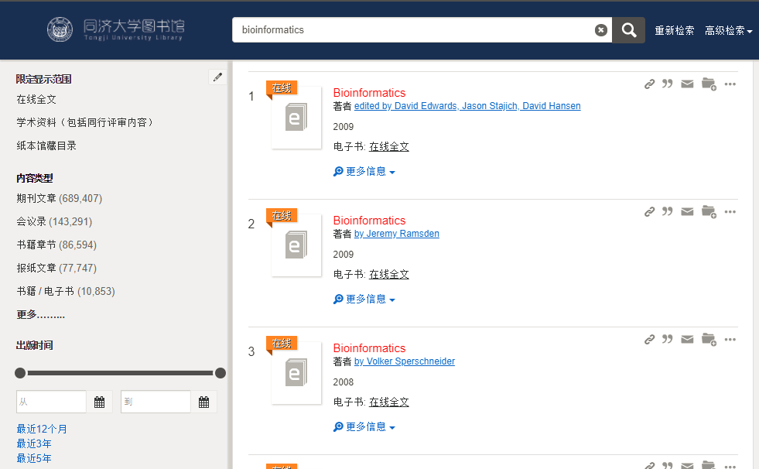
Review of results
Notes:
A search for “user interface” powered by SummonTM for a university library catalog returns a very large number of results
On the left users can see the number of results for categories organized by Content Type, Subject Terms, or Publication dates. It provides an overview of the results, reveals how the search was done (e.g. here the default search does not return dissertations) and facilitates further refinement of the search.
The menu at the upper right allows users to sort results by relevance or by date. Help is available with a “Chat now” button, to chat with a librarian.

Slide 30
Refinement
Search interfaces can provide meaningful messages to explain search outcomes and to support progressive refinement
Ask “Did you mean fibromyalgia?” when a term is misspelled
If multiple phrases were used, items containing all phrases should be shown first and identified, followed by items containing subsets
Users can do progressive refinement by changing the search parameters

Slide 31
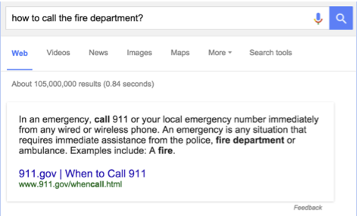
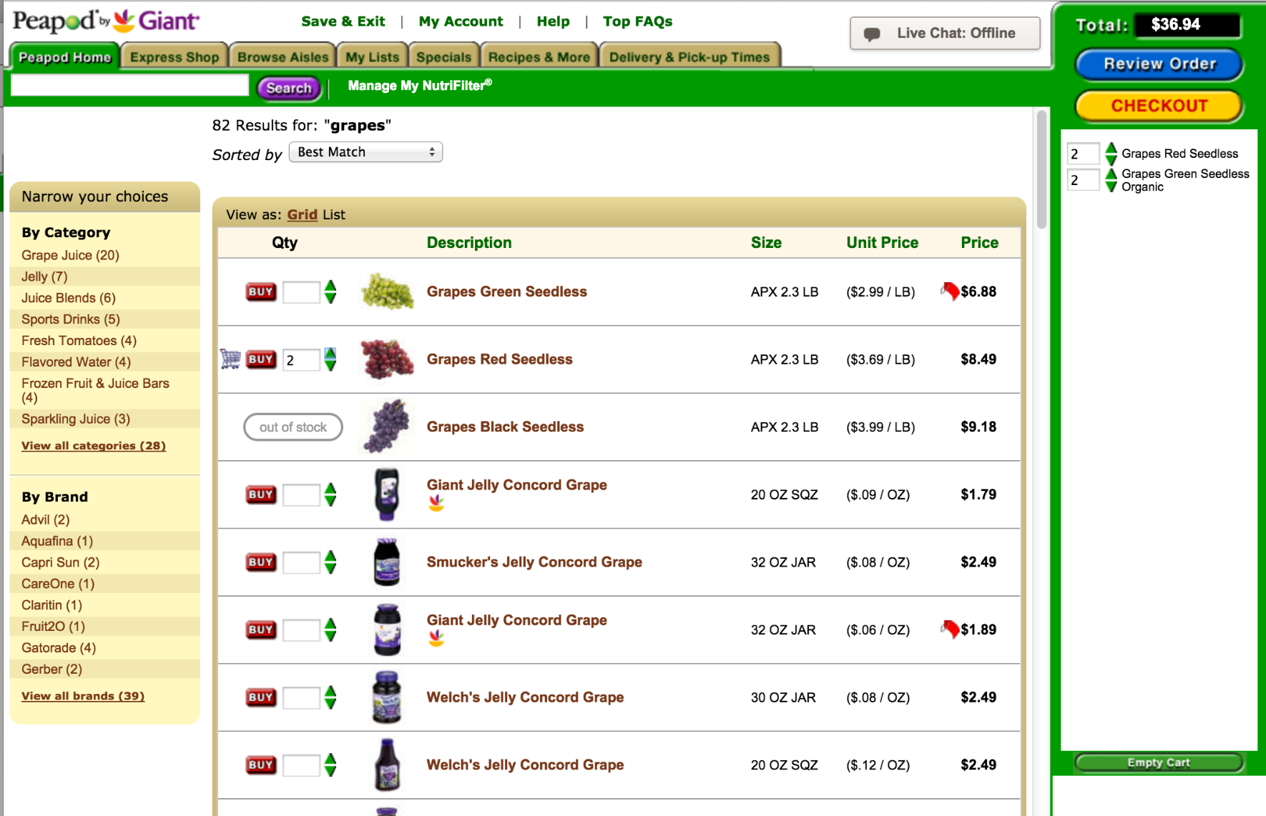
Use
Results may be merged and saved, disseminated by email, or shared in social media
When possible (and important), provide information or simple actions without requiring users to leave the search results page
On the left users get the answer to their safety critical question at the top of the result list
On the right shoppers looking for groceries can specify quantity and buy directly from the list of results after a search on “grapes”

Slide 32
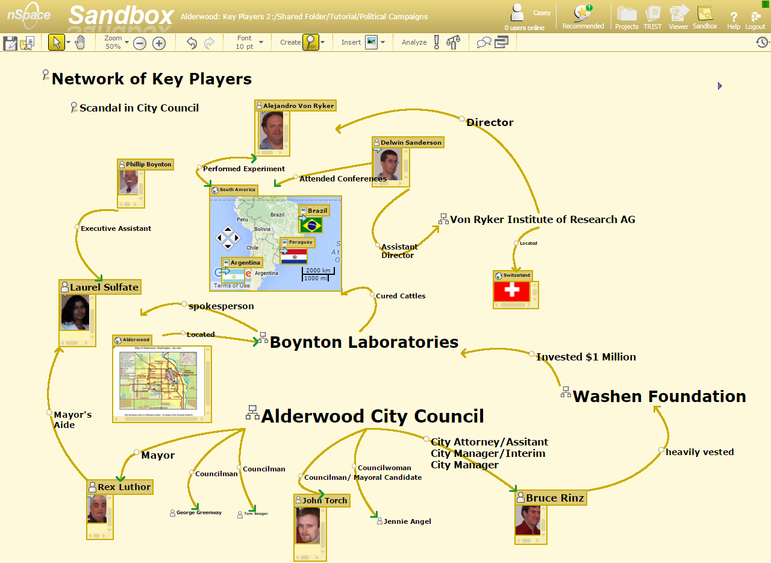
Use
Most often search is only one of many components of a more complex analysis tool
Notes:
nSpace Sandbox®, from Uncharted Software™ allows multiple analysts to organize and present the evidence gathered from research
A variety of tools such as node and link diagramming, automatic source attribution, recursive evidence marshalling, timeline construction, etc. provide support for analysis and reporting

Slide 33
Outline
Introduction
Five-stage search framework
Dynamic queries and faceted search
Command languages and “natural” language queries
Multimedia Document Search & specialized search
The Social aspects of search

Slide 34
Dynamic queries and faceted search
When metadata is available, dynamic query interfaces provide
A visual representation of the possible actions
A visual representation of the objects being queried
Rapid, incremental, and reversible actions and immediate feedback
The dynamic query approach is appealing as it prevents errors and encourages exploration

Slide 35
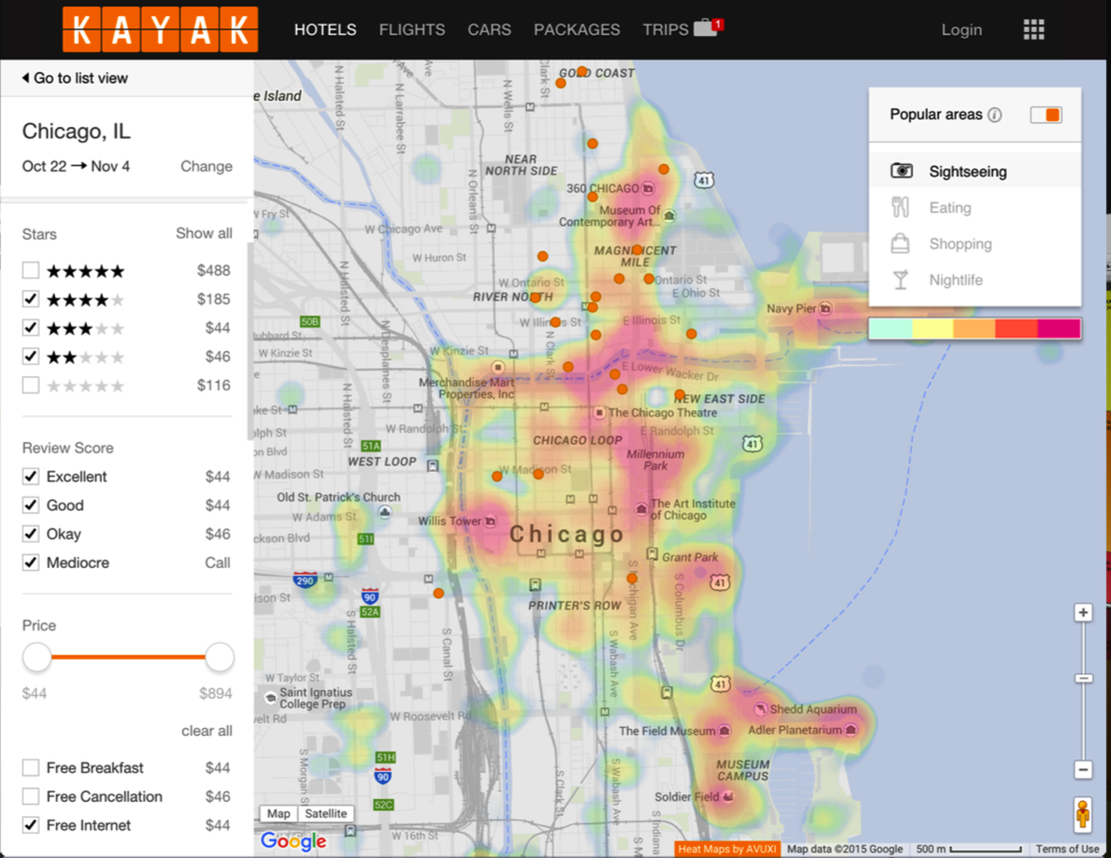
Dynamic queries and faceted search
Visual search interface
The hotel search interface of the Kayak travel website
Notes:
After using a form fill-in to provide the location (Chicago) and dates results are displayed in a traditional list or a map
The map provides an overview of the location of the hotels and can be zoomed to narrow the results. It was also augmented with a visualization of the popular sightseeing areas.
On the left menus are available to narrow down the categorical values, and sliders for numerical values
Price is important so the average price is provided for each category values

Slide 36
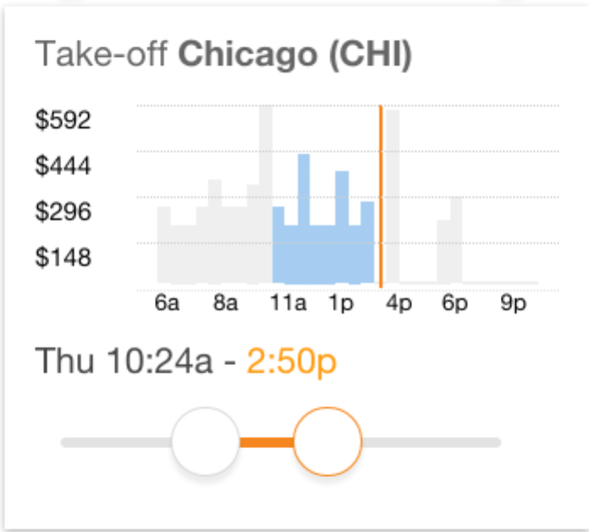
Dynamic queries and faceted search
A preview of the price of available flights guides users narrow down the time range for take-off
The preview eliminates empty result sets, and avoids high expenses

Slide 37
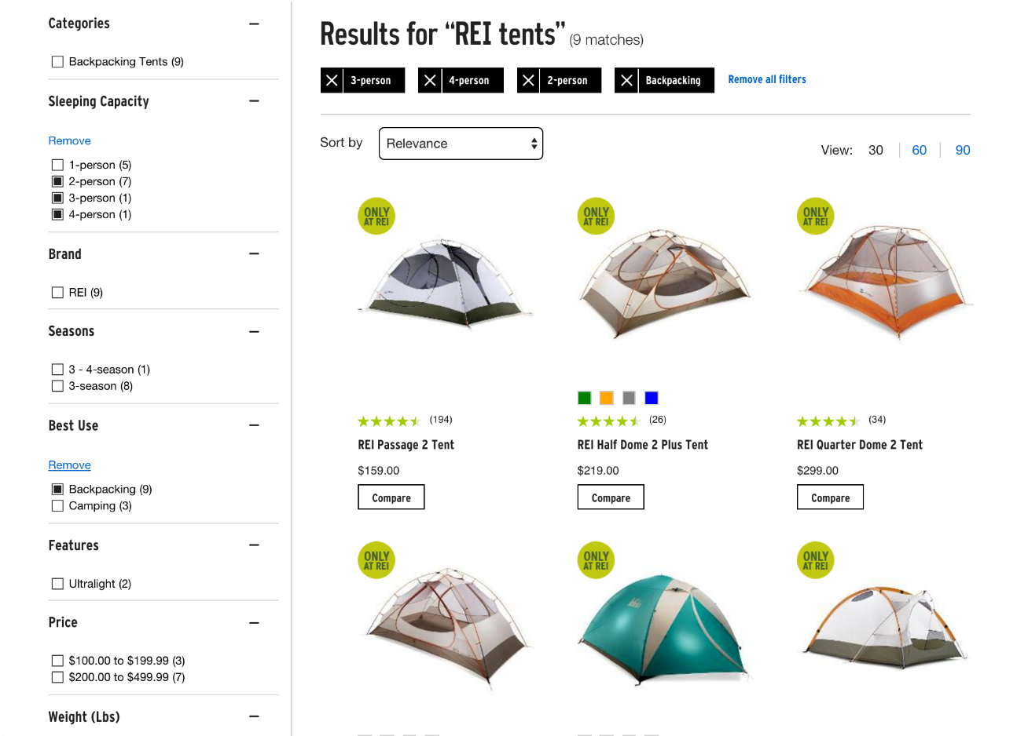
Dynamic queries and faceted search
Faceted search interface of REI
faceted
faceted
Notes:
Here users searched for “REI tents” and then browsed different tents by selecting values for multiple categories
The selected filters are clearly indicated at the top with black background, making easy for users to review the constraints and remove them

Slide 38

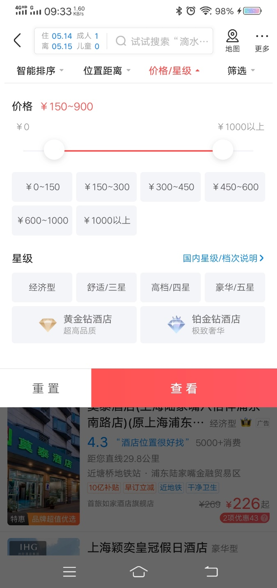
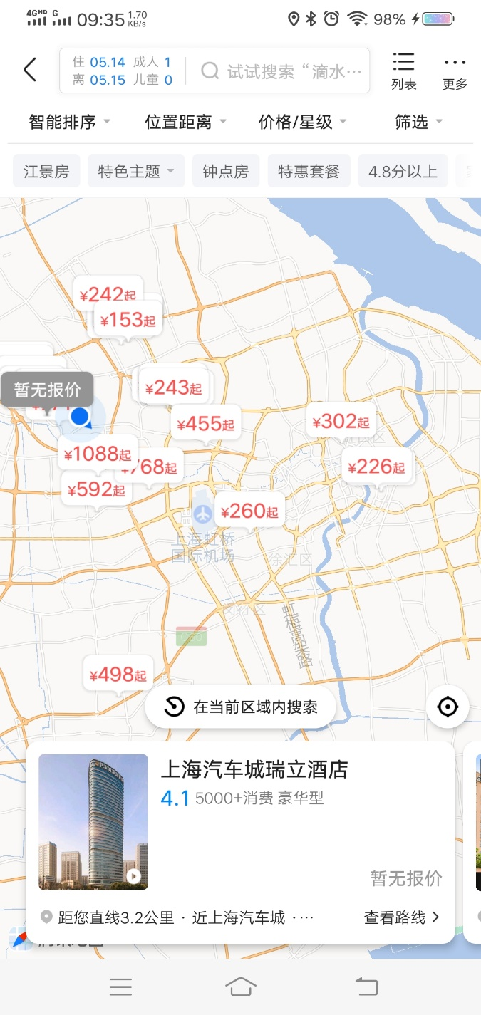
Dynamic queries and faceted search

Slide 39
Outline
Introduction
Five-stage search framework
Dynamic queries and faceted search
Command languages and “natural” language queries
Multimedia Document Search & specialized search
The Social aspects of search

Slide 40
Command languages queries
Users may want more control over their queries
Regular expressions allow users to specify patterns of allowed variants
Typing “*terro*” to return documents with “terrorist,” “terrorism,” or “anti-terrorism”
The Structured Query Language (SQL) is a widespread standard for searching relational database systems
SELECT DOCUMENT#
FROM JOURNAL-DB
WHERE (DATE >= 2014 AND DATE <= 2017)
AND (LANGUAGE = ENGLISH OR FRENCH)
AND (PUBLISHER = ASIST OR HFES OR ACM)
Notes:
Form filling, dynamic queries, and faceted search allow users to specify fairly complex queries. A subset of Boolean queries is possible (Ors between attribute values and ANDs between attributes), but some users may want even more control over their queries.

Slide 41
“Natural” language queries
Boolean expressions conflict with English usage
“List all employees who live in New York and Boston”
“I’d like Russian or Italian salad dressing”
Web search with “natural” language queries is appealing
Often the semblance of a natural language query is achieved simply because the answers has been provided by human
“How do I fix a flat?”
“Howe do I connect wii and dvd to my tv?” – video selector or two way A/V switcher

Slide 42
Outline
Introduction
Five-stage search framework
Dynamic queries and faceted search
Command languages and “natural” language queries
Multimedia Document Search & specialized search
The Social aspects of search

Slide 43
Multimedia document search & other specialized searches
Image search
Video search
Audio search
Geographic information search
Multilingual search
Other specializes searches

Slide 44
Multimedia document search
Interfaces for multimedia document search have been gradually improved
Most systems depend on text searches, keywords, tags, and metadata
But many multimedia documents remain untagged
Multimedia-document search interfaces that integrate powerful annotation and indexing tools, search algorithms, and media-specific browsing techniques for viewing the results lead to successful outcomes

Slide 45

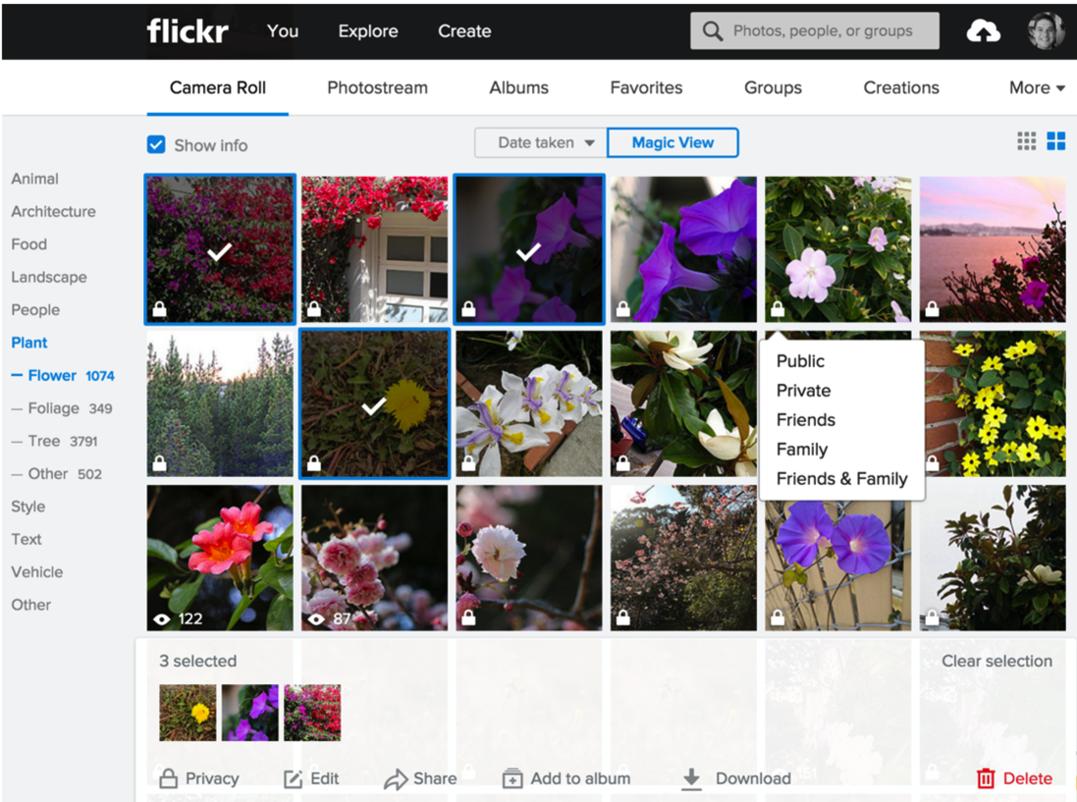
Image search
Image-analysis researchers describe this task as query by image content (QBIC)
Another important applications: Face recognition
Notes:
The “Magic View” of Yahoo photos automatically generates topic tags for each photo
Here users selected the photos with flowers
Three photos are selected and ready to be shared
The privacy setting is visible and can be changed with a menu

Slide 46
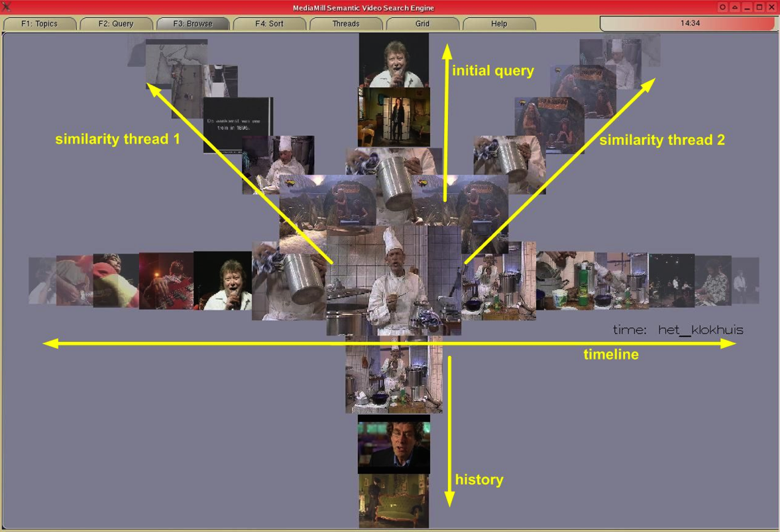
Video search
Identifying videos that include objects, actions, or events of interest and analyzing them remains a challenge
Video analysis include object tracking, text in the scenes, and speech-to-text transcripts
Notes:
The ForkBrowser of the MediaMill semantic video search engine (de Rooij, 2008) which allows the user to browse the video collection along various dimensions exploring different characteristics of the collection

Slide 47
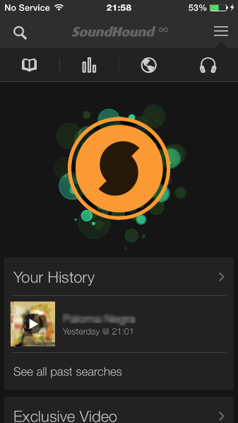
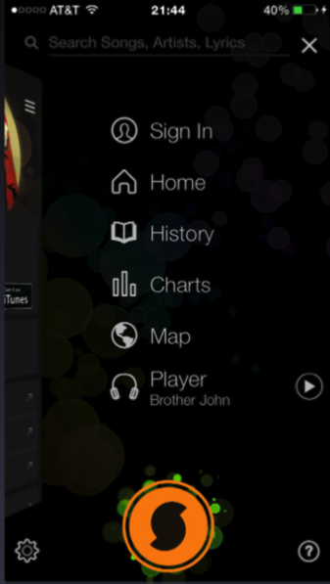
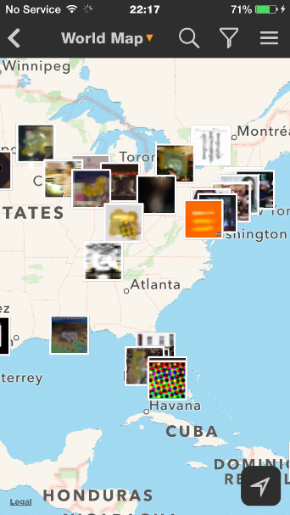
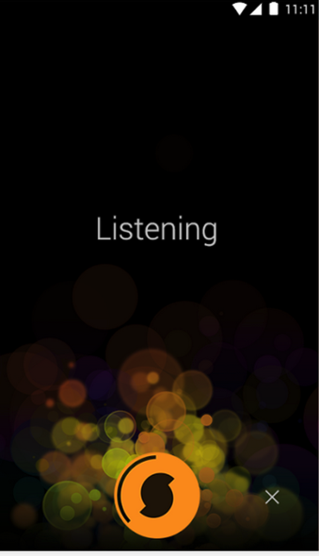
Audio search
Music-information retrieval systems use audio input, where users can query with musical content
Users can sing or play a theme, and the system returns the most similar items

Slide 48
Geographic information search
Geographic information is increasingly used to inform search
Sensors on the ground or onboard vehicles provide the information for queries
“Where is the closest gas station?”
User interfaces providing map displays allow users to geographically consider the results
Challenges need to be addressed
What to show on the map
Design dynamic legends
Improve interaction with maps

Slide 49
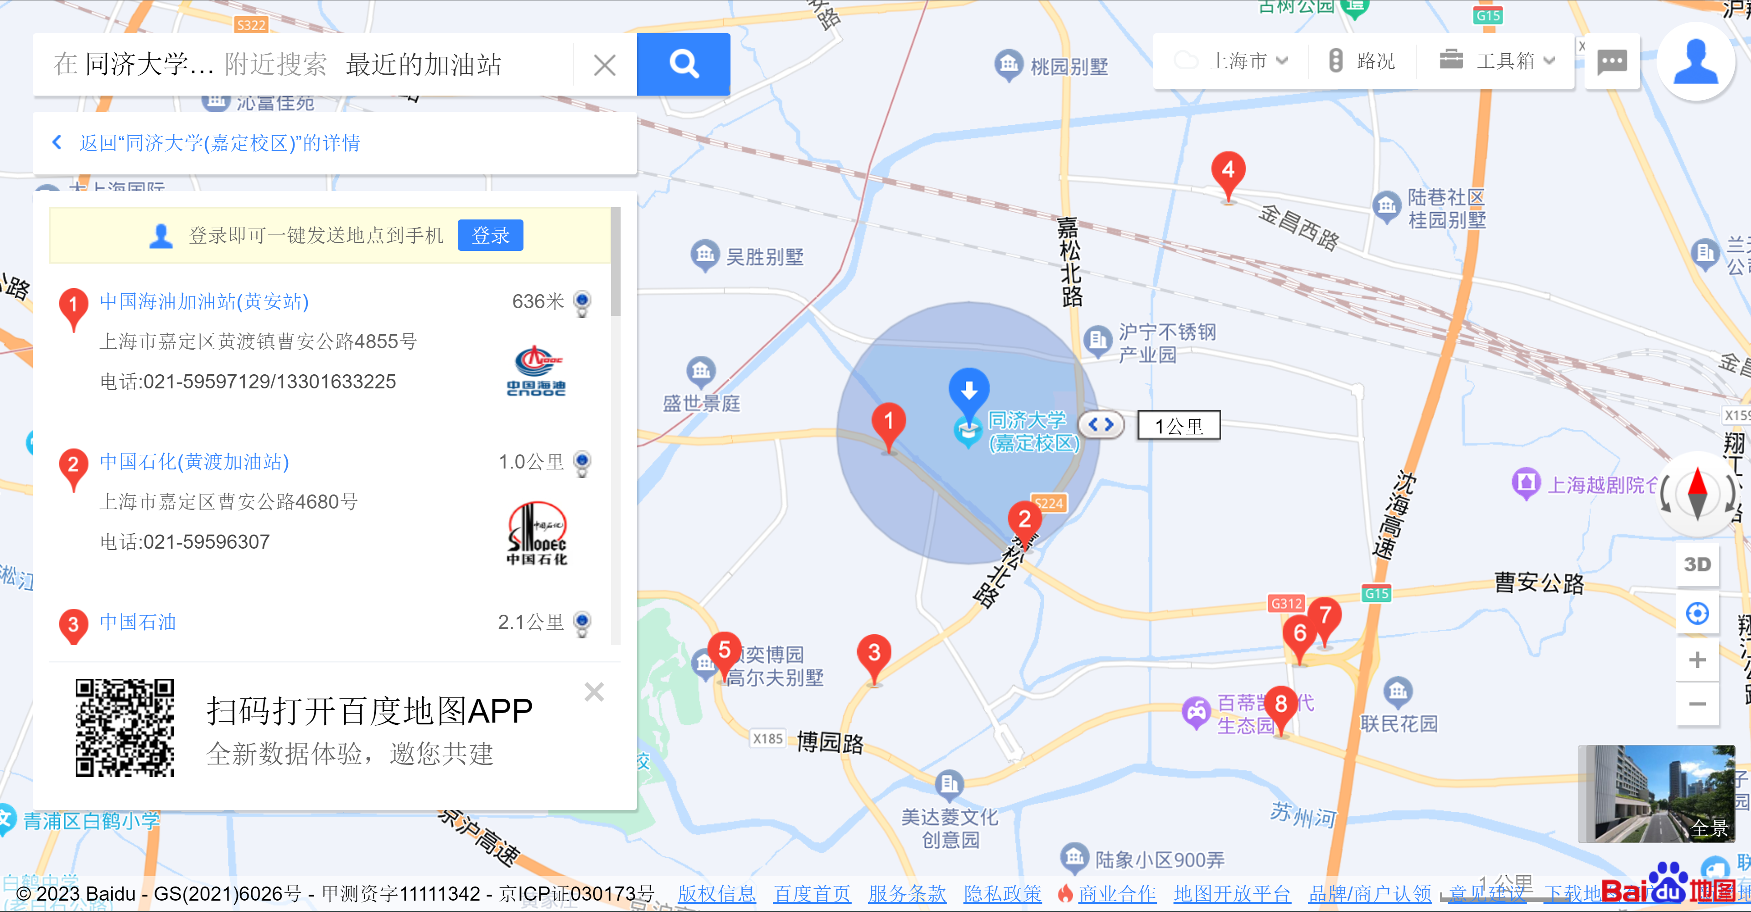
Geographic information search

Slide 50
Outline
Introduction
Five-stage search framework
Dynamic queries and faceted search
Command languages and “natural” language queries
Multimedia Document Search & specialized search
The Social aspects of search

Slide 51

The social aspects of search
Social search is “an umbrella term” describing search acts that make use of social interactions with others
May be explicit or implicit, co-located or remote, synchronous or asynchronous
Social bookmarking and ranking, e.g. Reddit
Personalized search built on user profiles, e.g. past site visits
Collaborative filtering and recommender systems, e.g Netflix
Music recommendation, e.g. Pandora
Human-powered question answering

Slide 52
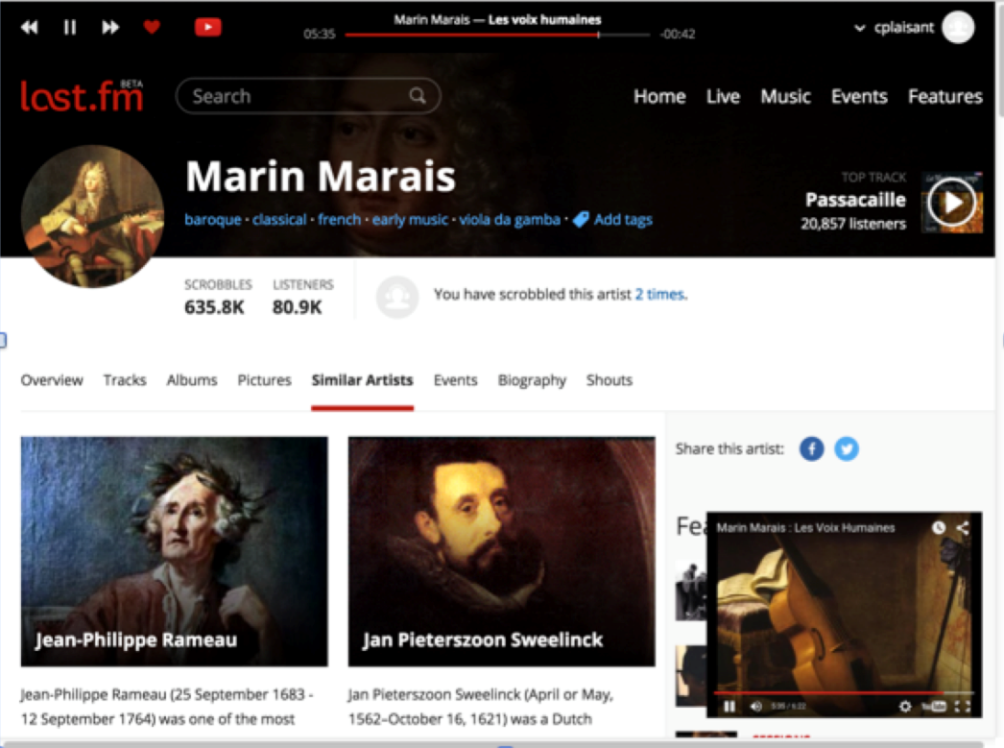
The social aspects of search
Last.fm is an example of online radio using playlists created automatically
The process starts by users selecting a start point (e.g. a song or artist they like) then users provide feedback on the suggestions by clicking on the heart or skipping the track

